Slide 1

Title: Emotion Detection using Image processing Techniques
JSS Academy of Technical Education
UNDER THE GUIDANCE OF
DR MALINI M PATIL
ARAvinda Bs 1js15is009
Ishwarya narahari 1js15is029
Abhishake K 1js15is001
Sahana B 1js16is400

Slide 2
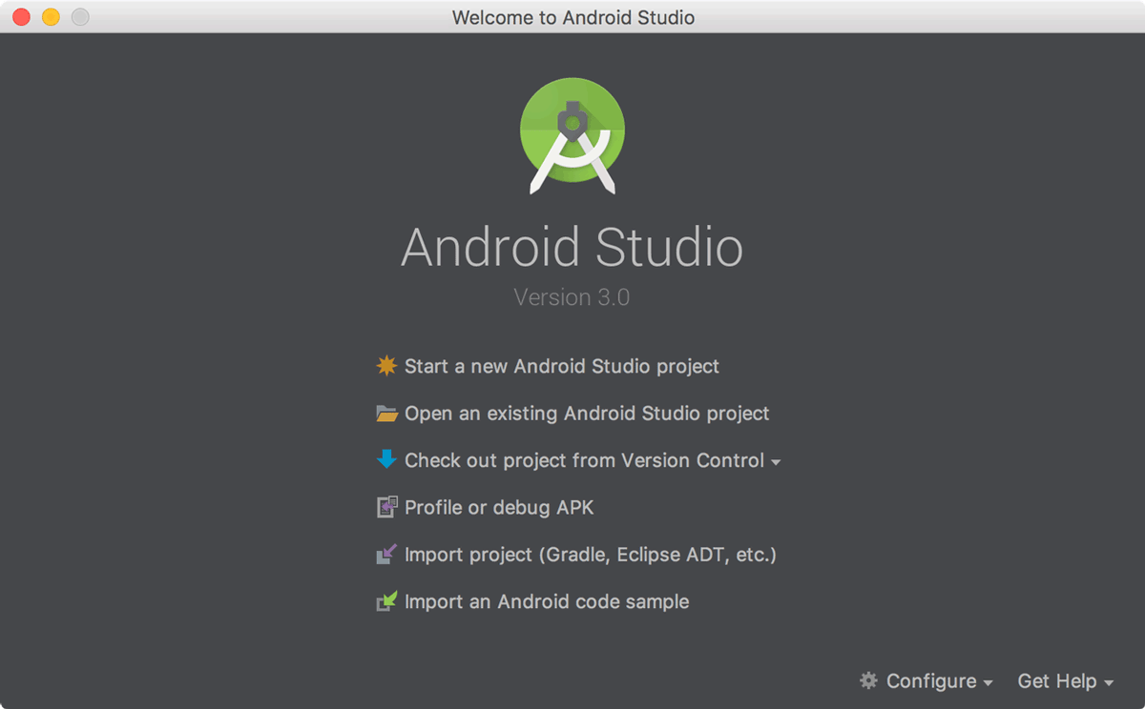
How to build a simple app
In the Welcome to Android Studio window, click Start a new Android Studio project.
In the Create New Project window, enter the following values:
Application Name: "My First App"
Company Domain: "example.com"
You might want to change the project location. Also, if you want to write a Kotlin app, check the Include Kotlin support checkbox. Leave the other options as they are.

Slide 3
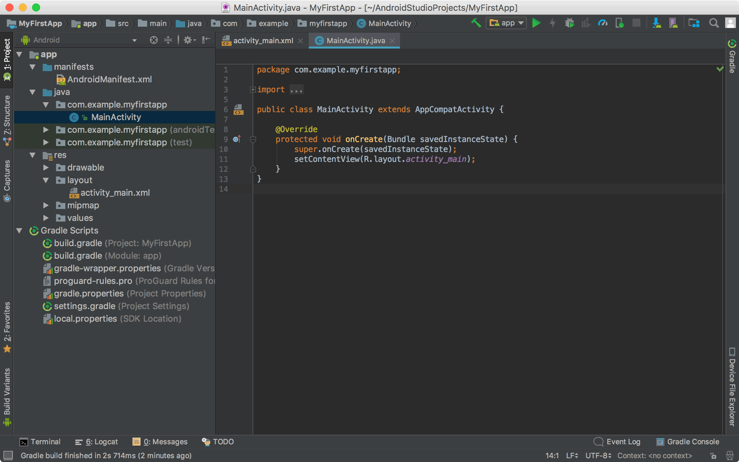
Creating a simple app
4. Click Next.
5. In the Target Android Devices screen, keep the default values and click Next.
6. In the Add an Activity to Mobile screen, select Empty Activity and click Next.
7. In the Configure Activity screen, keep the default values and click Finish.

Slide 4
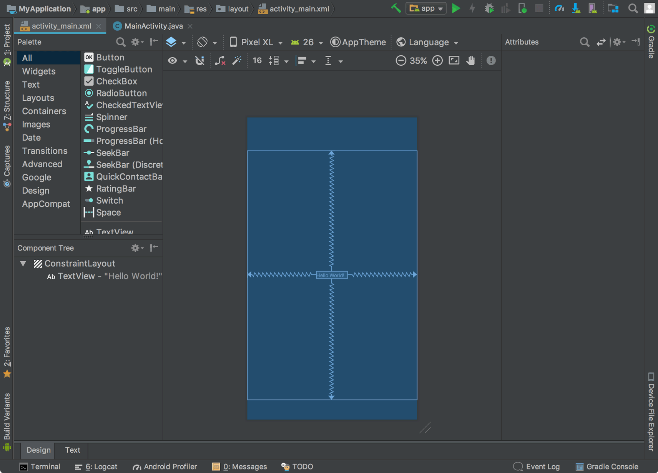
Drag and Drop in Android Studio
In Android Studio's Project window, open app > res > layout > activity_main.xml.
To make more room for the Layout Editor, hide the Project window by selecting View > Tool Windows > Project.
If your editor shows the XML source, click the Design tab at the bottom of the window.
Click Select Design Surface and select Blueprint.
Click Show in the Layout Editor toolbar and make sure Show Constraints is checked.

Slide 5
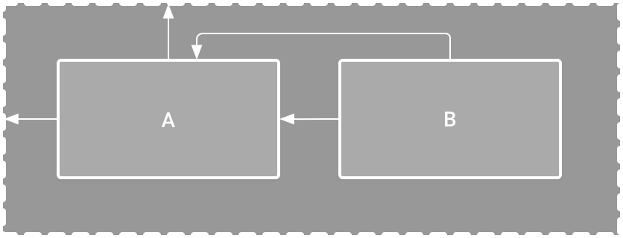
Component Dependencies
View A appears 16dp from the top of the parent layout.
View A appears 16dp from the left of the parent layout.
View B appears 16dp to the right of view A.
View B is aligned to the top of view A

Slide 6
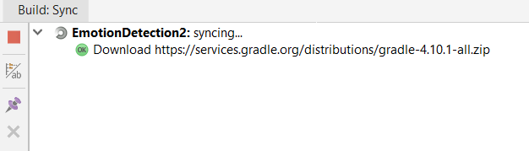
What is a Gradle
This is where the build system enters the picture. The build system automatically takes all the source files (.java or .xml), then applies the appropriate tool (e.g. takes java class files and converts them to dex files), and groups all of them into one compressed file, our beloved APK.

Slide 7
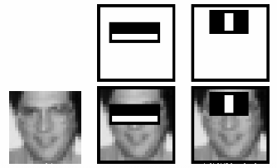
Haar Cascade in OpenCV
OpenCV comes with a trainer as well as detector. If you want to train your own classifier for any object like car, planes etc. you can use OpenCV to create one.
Here we will deal with detection. OpenCV already contains many pre-trained classifiers for face, eyes, smile etc. Those XML files are stored in opencv/data/haarcascades/ folder.
For this they introduced the concept of Cascade of Classifiers. Instead of applying all the 6000 features on a window, group the features into different stages of classifiers and apply one-by-one.

Slide 8

What is Open CV
OpenCV (Open Source Computer Vision Library) is an open source computer vision and machine learning software library.
OpenCV was built to provide a common infrastructure for computer vision applications and to accelerate the use of machine perception in the commercial products.
OpenCV makes it easy for project to utilize and modify the code.

Slide 9
What we have developed
Basic andriod app with minimal User interface
The app asks for camera permission and then opens for the camera
We must note that permission is asked only once
The app as of now can take screenshot of the image and can flip the camera so that we can use for front and rear end camera

Slide 10
Things we need to work on
As of now we are working on face detection
The app is crashing when it encounters an object which we believe happens when it finds a face
We need to still improve this part and stabilise the app.

Slide 11
Next Phase
Once face detection is successfully integrated into the android app we will move onto emotion detection
Basic emotions shall be worked on first and then we will move on to more complex emotions.

